Slide 1





Introduction to Robotic Process Automation
CINECONNECT: STREAMLINED MOVIE REGISTRATION AND REVENUE TRACKER
220701171
Mohnish M
Mrs G.M. Sasikala M.E
Computer Science and Engineering

Slide 2
Abstract
This project leverages Robotic Process Automation (RPA) to streamline the process of movie registration and revenue tracking. Developed using UiPath, the automation extracts movie details from an Excel file and performs predefined operations such as data validation and formatting. The processed data is then automatically emailed to stakeholders, ensuring accurate and timely updates without manual intervention. This system enhances efficiency, reduces human errors, and accelerates workflow by automating repetitive tasks, making it an ideal solution for managing high volumes of data in a time-sensitive environment.

Slide 3
Need for the Proposed System
Manual movie registration and revenue tracking are time-consuming and error-prone, especially when dealing with large datasets. The existing manual process increases the risk of data inconsistencies and delays in reporting. To address these challenges, an RPA-based solution is proposed, which automates repetitive tasks like data extraction, validation, and emailing. This system ensures accuracy, reduces human intervention, and improves operational efficiency. By implementing this solution, businesses can streamline workflows, focus on strategic tasks, and enhance decision-making through timely and reliable data processing.

Slide 4
Advantages of the Proposed System
Accuracy and Consistency: Automated data entry eliminates human errors, ensuring precise and reliable information across processes.
Time Efficiency: Reduces the time required to perform repetitive tasks, allowing quicker completion of workflows.
Cost-Effective: Minimizes dependency on human labor, leading to reduced operational costs.
Improved Productivity: Frees up staff to focus on higher-value tasks, boosting overall productivity.
Scalability: Capable of handling large volumes of data with ease, adapting to growing business needs.
Real-Time Processing: Instant data processing and email reporting improve decision-making and responsiveness.

Slide 5
Literature Survey
Paper 1: "Robotic Process Automation for Movie Management"
Summary: This paper highlights the use of RPA to automate tasks like movie registration and revenue tracking, leveraging tools like UiPath. The implementation significantly enhances accuracy and reduces manual effort in data management.
Advantages:
Automates repetitive tasks, saving time.
Reduces human errors, improving data accuracy.
Increases operational efficiency and productivity.
Disadvantages:
High initial setup time and cost.
Requires structured data for optimal performance.
Ongoing maintenance and technical expertise are needed.

Slide 6
Literature Survey
Paper 2: "Automating Revenue Tracking Using RPA Tools"
Summary: This paper explores the integration of RPA in financial systems, specifically for automating revenue tracking. It examines how RPA bots streamline processes such as data extraction, validation, and report generation, resulting in faster and more reliable financial management.
Advantages:
Enhances accuracy in revenue tracking and reporting.
Reduces the manual workload, saving time for finance teams.
Provides real-time data insights, improving decision-making.
Disadvantages:
High initial costs for implementation.
Limited adaptability to unexpected data format changes.
Continuous monitoring and updates are required for maintaining system efficiency.

Slide 7
Main Objective
The main objective of the CineConnect: Streamlined Movie Registration and Revenue Tracker project is to automate the movie ticket booking process, revenue tracking, and communication between users and theater owners. Users can select movie details such as the movie, seat, row, and screen, and enter their email for confirmation, with the system validating that only college domain emails are accepted. The booking details are stored in an Excel sheet for easy record-keeping. The owner can input ticket prices and the number of tickets sold to calculate the revenue, and the system automatically sends booking confirmations and revenue summaries via email to both users and owners, ensuring a smooth and efficient workflow.

Slide 8
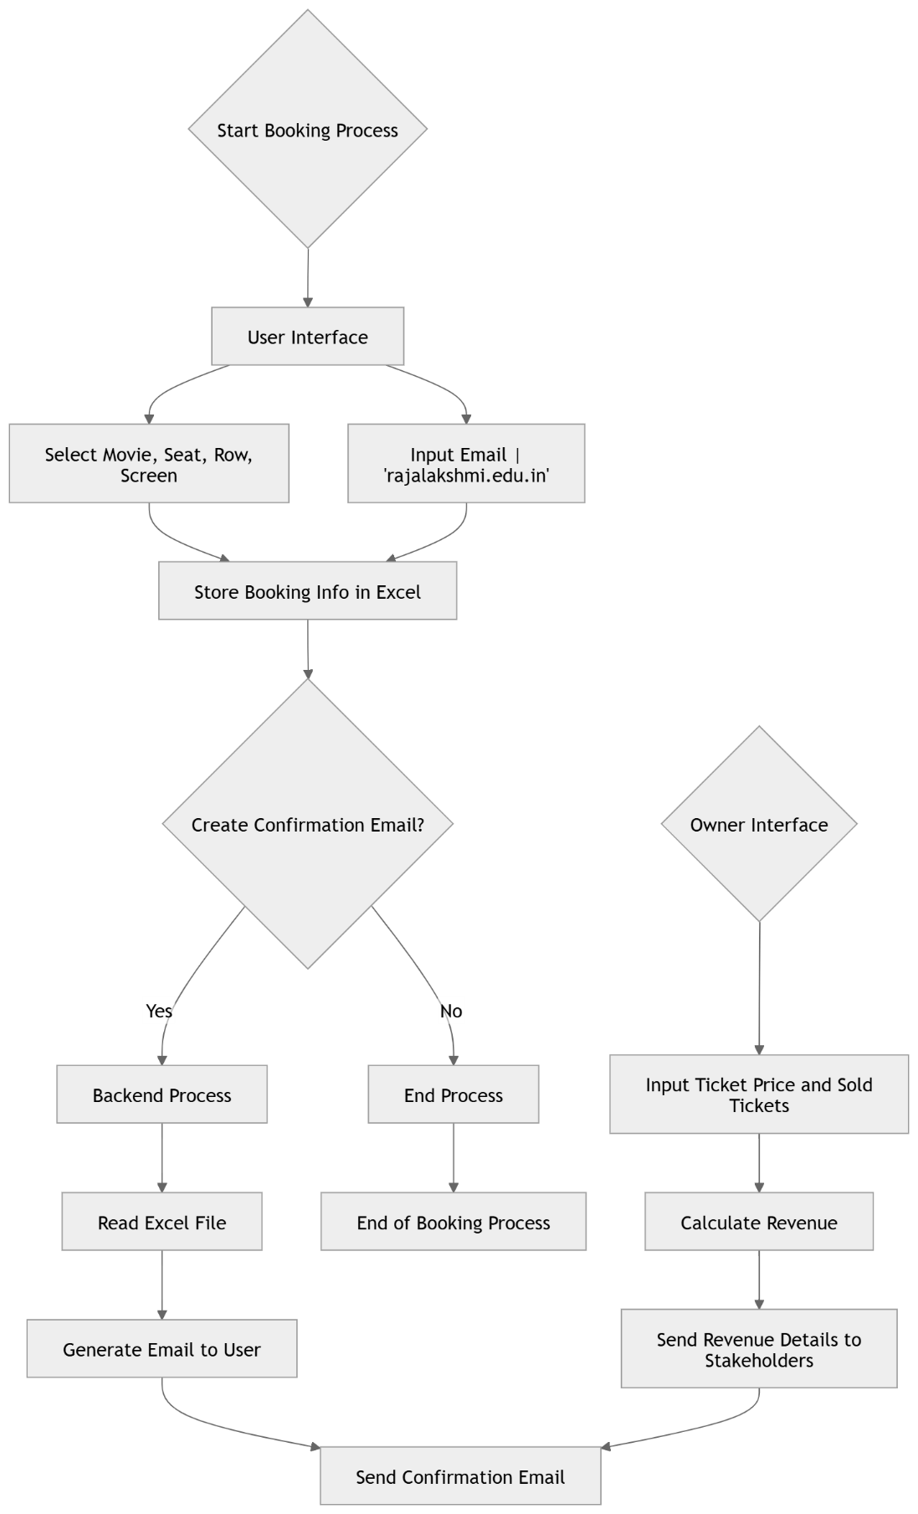
Architecture

Slide 9
System Requirements
Hardware Requirements:
Processor: Intel i3 or higher (recommended Intel i5 or above).
RAM: Minimum 4 GB (8 GB recommended for optimal performance).
Storage: At least 10 GB free space.
Internet: Stable connection for Google Form submissions.
Software Requirements:
RPA Tool: UiPath Studio (Community or Enterprise edition).
Browser: Google Chrome with UiPath extension installed.
Data Source: Microsoft Excel or other structured data formats.
Operating System: Windows 10 or later (64-bit)

Slide 10
Functional Description
Module 1: Data Extraction and Processing (For CineConnect Project)
In this module, the goal is to automate the extraction of movie booking details from user input and process it for storage and email communication. The process involves collecting relevant data like the movie title, selected seat, row, screen, and user email, and then validating and formatting this data to ensure it’s in the correct format for both Excel storage and email communication. Key tasks include:
Data Extraction: Collecting movie booking details such as the user's name, selected movie, seat, row, screen, and email from user input.
Data Validation: Ensuring the email entered is valid, specifically checking that it belongs to the college domain (e.g., "@rajalakshmi.edu.in"). Additionally, verifying that all fields (movie, seat, email) are filled correctly before proceeding.
Data Processing: Formatting the extracted data (e.g., ensuring the seat and row details are correctly structured), organizing it into an appropriate format for storing in an Excel sheet. The processed data will be stored in Excel and used for generating reports, calculating revenue, and sending email confirmations.

Slide 11
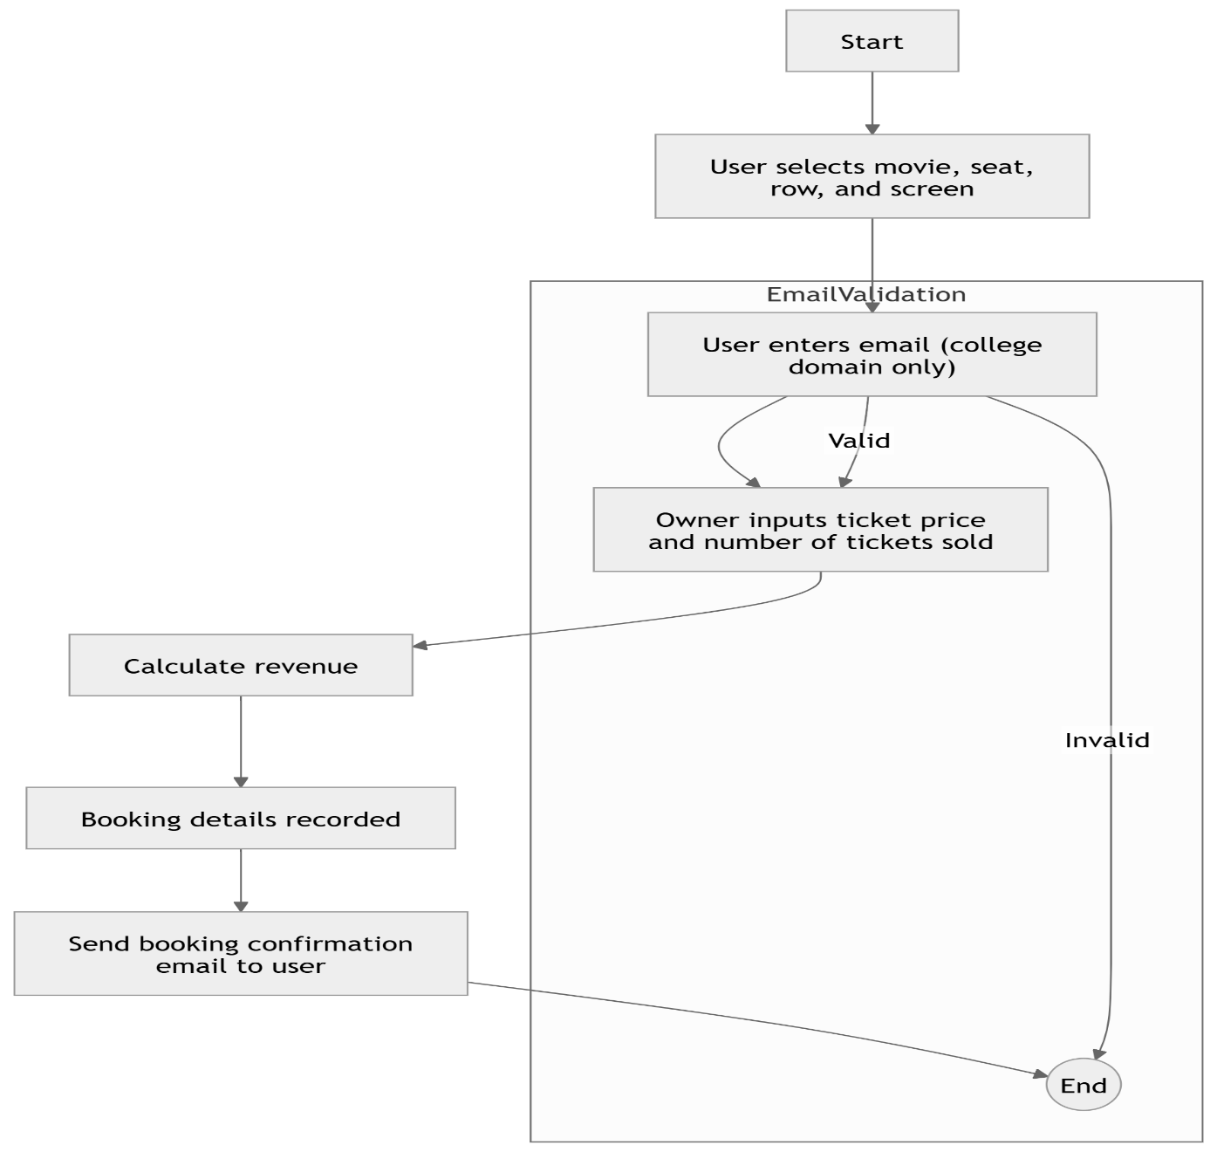
Functional Description
Activity Diagram

Slide 12
Functional Description
Module 2: User Interaction and Booking Validation
In this module, the focus is on automating the user interaction process for movie ticket booking and validating the input data. The user will be prompted to select a movie, screen, row, and seats for their booking. Additionally, the user will enter their email address, with the system validating that only emails from the college domain (e.g., @rajalakshmi.edu.in) are accepted. Once the input data is validated, the system will process the booking details, including calculating the number of available seats and ensuring that no double-booking occurs. Key tasks include:
User Input Collection: Prompting the user to choose movie details, seat, row, screen, and email.
Email Validation: Verifying that the email belongs to the valid college domain.
Seat Availability Check: Ensuring the selected seats are available before confirming the booking.
Data Confirmation: Displaying the booking details for user confirmation before finalizing the reservation.

Slide 13
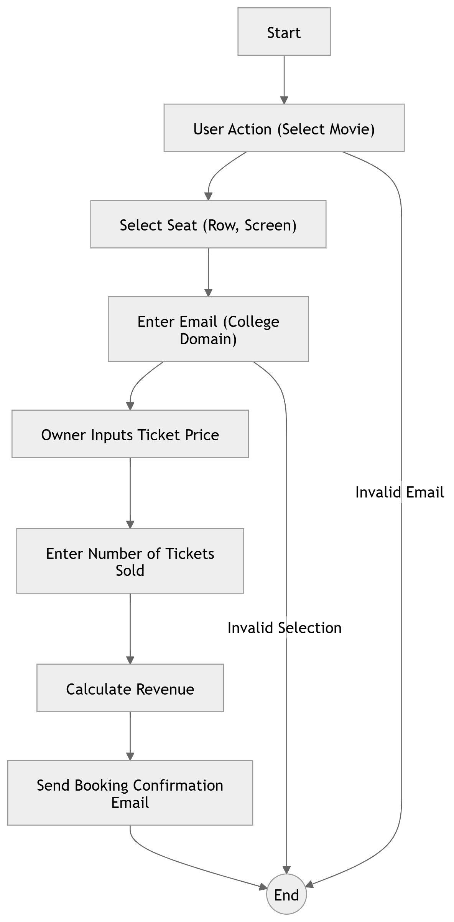
Functional Description
Activity Diagram

Slide 14
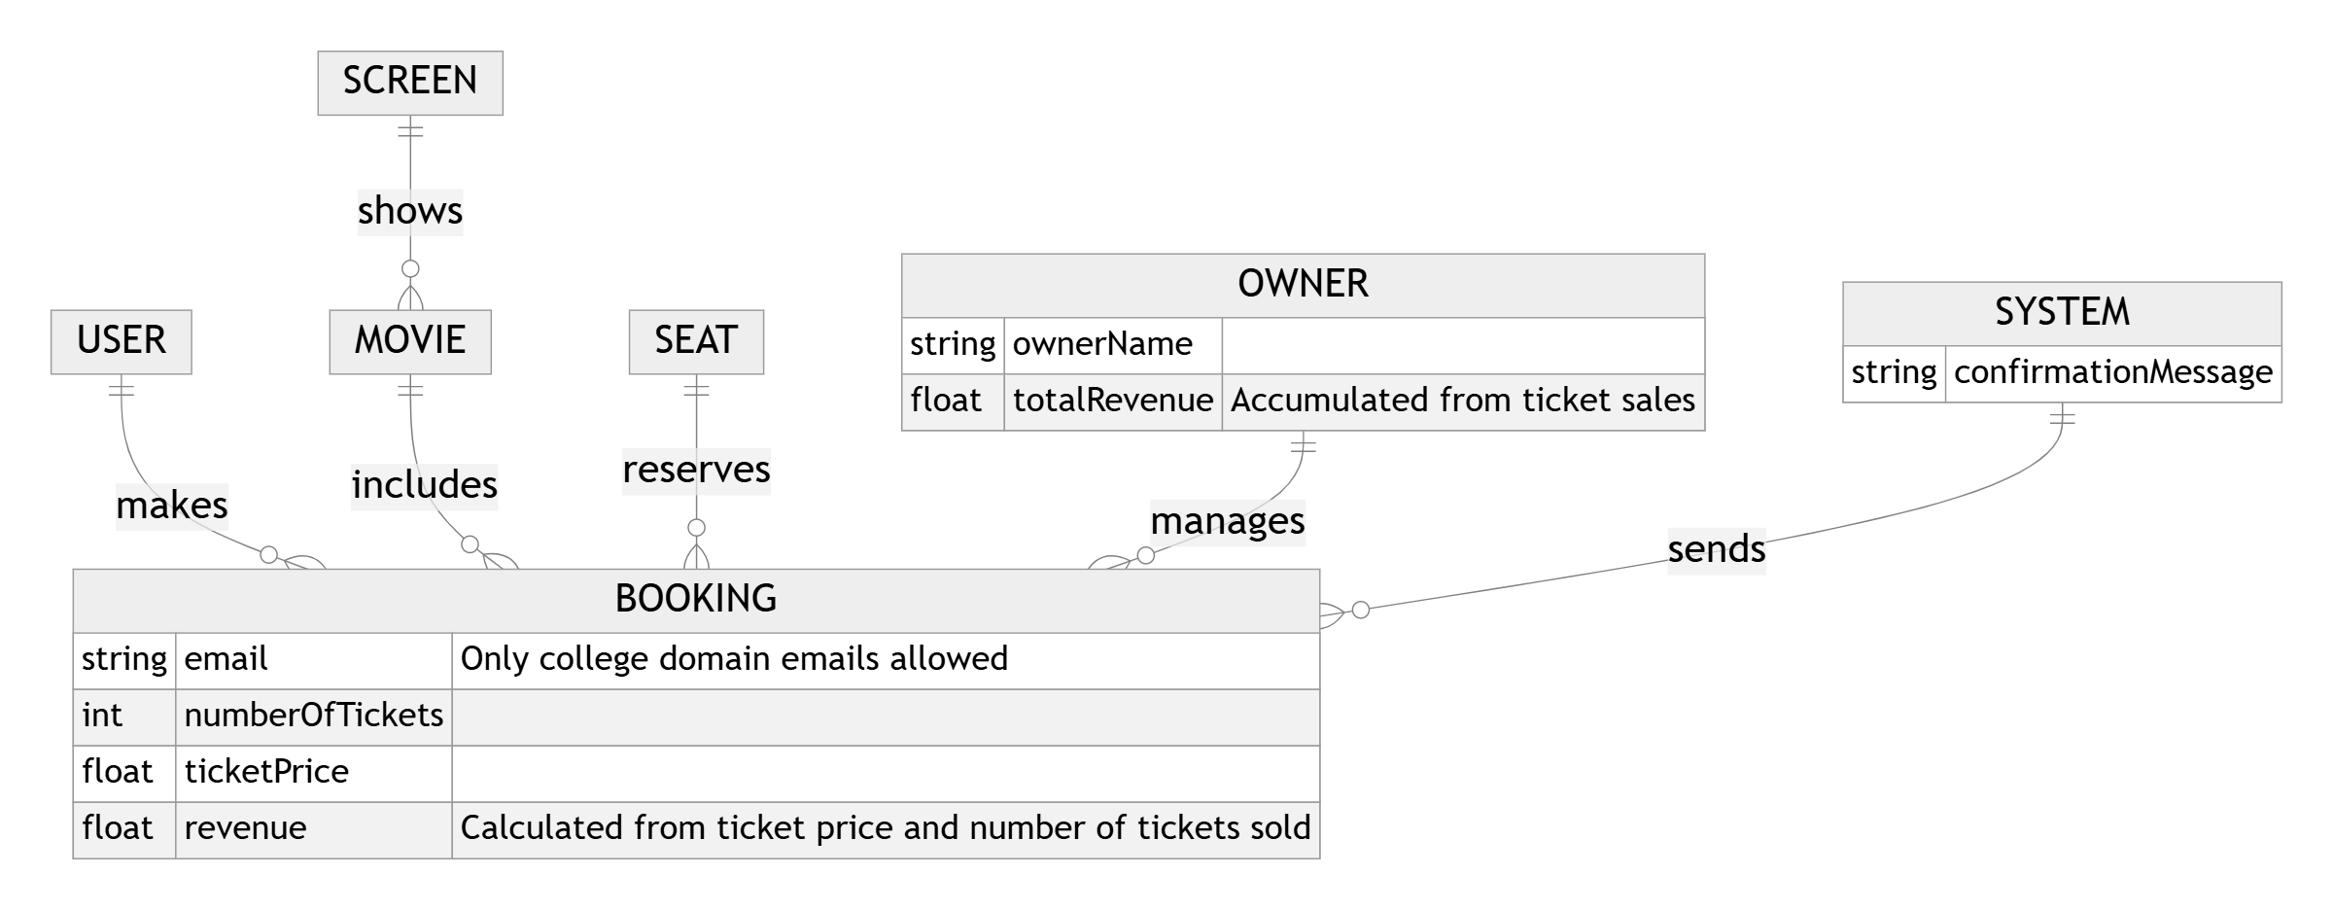
Table Design
Entity Relationship Diagram

Slide 15
Process Design
Main Process : User Booking Process
Process User Booking The user selects a movie, preferred seat, row, and screen from the available options. The system then validates the email to ensure it is a valid college email. After confirmation, the booking details are stored in an Excel sheet, and an email with booking information is sent to the user. If the email is not successfully sent, the system logs the error and retries.
Confirmation and Reporting Once the user details are successfully processed, a confirmation email is sent with booking information, including the movie, seat, and row. The system logs the booking details and generates a report to track successful and failed bookings. If any errors occur during email sending or data entry, they are captured in the system logs for follow-up actions

Slide 16
Process Design
Main Process : Owner Revenue Calculation and Reporting
Revenue Calculation The owner inputs the ticket price and the number of tickets sold. The system calculates the total revenue based on the ticket price and sold quantity. This calculation is recorded, and any discrepancies in the inputs are flagged for review. The system updates the Excel sheet with the latest revenue information for tracking purposes.
Summary Report Generation After revenue calculation, the system generates a summary report showing the total revenue and the number of tickets sold. This report includes detailed information on the ticket sales, which can be reviewed by the owner. Any errors or discrepancies in the data are logged for resolution before the process ends.

Slide 17
Process Design
Subprocess: Email Notification to User
Process Email Notification Once the booking details are successfully stored, the system triggers an email notification to the user. The email contains the booking confirmation, including the selected movie, seat, and screen information. The email is sent only if the user’s email is a valid college email.
Error Handling If the email fails to send, the system logs the error with details about the failure (e.g., invalid email, server issue) and retries the email process. If the error persists, it sends an alert to the admin for further action, ensuring that the user is eventually notified.

Slide 18
Process Design
Subprocess: Revenue Calculation for Owner
Process Revenue Calculation After collecting ticket sales data, the owner inputs the number of tickets sold and the ticket price. The system automatically calculates the total revenue by multiplying the ticket price by the number of tickets sold, providing a quick and accurate report.
Report Generation The system generates a detailed revenue report and saves it in an Excel file for the owner's records. If any discrepancies are found during the calculation (e.g., missing data or incorrect entries), an alert is triggered for the owner to review and correct the inputs before finalizing the revenue.

Slide 19
Implementation
Module 1: Initialize and Setup for Movie Ticket Booking System
The "Initialize and Setup" module prepares the environment for the movie ticket booking process. In this stage, key variables are initialized, such as the movie details, seat availability, and user inputs (email, selected movie, seat, row, screen). The Excel sheet containing movie and seat data is loaded to track the available seats, and the email validation function is set up to ensure that only valid college emails are accepted. The system is configured to ensure smooth interaction with the user interface and to prevent errors in the booking process. This module also prepares the email setup for sending the booking details to the user after successful ticket booking.

Slide 20
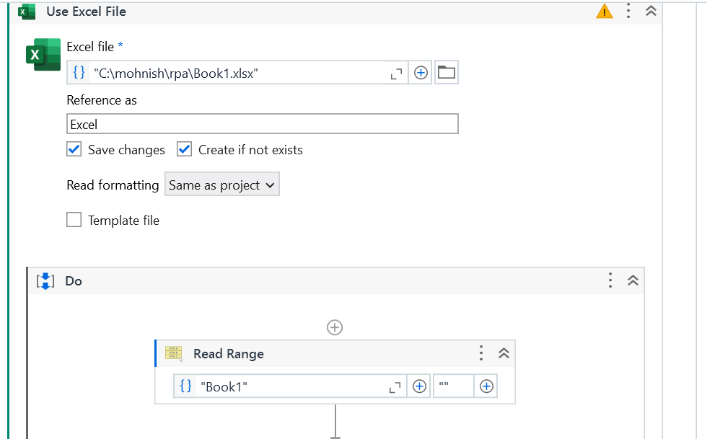
Implementation
Screen Shots

Slide 21
Implementation
Module 2: Data Extraction and Validation for Movie Ticket Booking System
The workflow uses UiPath’s Read Range activity to extract the booking data from the Excel file, which contains details such as available movies, seats, and booking information. After loading the data into a structured data table, the workflow performs validation checks to ensure that the movie, seat, row, screen, and user email are properly formatted and filled. Specifically, the email is checked to ensure it follows the college-specific domain format. If any required fields are missing or incorrectly formatted, they are flagged for review, preventing incomplete or invalid bookings. Once the data passes validation, the system moves forward with processing the user’s selections and booking the tickets.

Slide 22
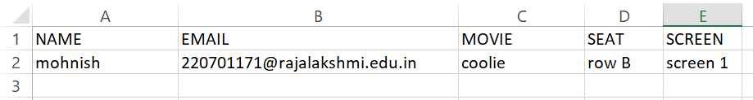
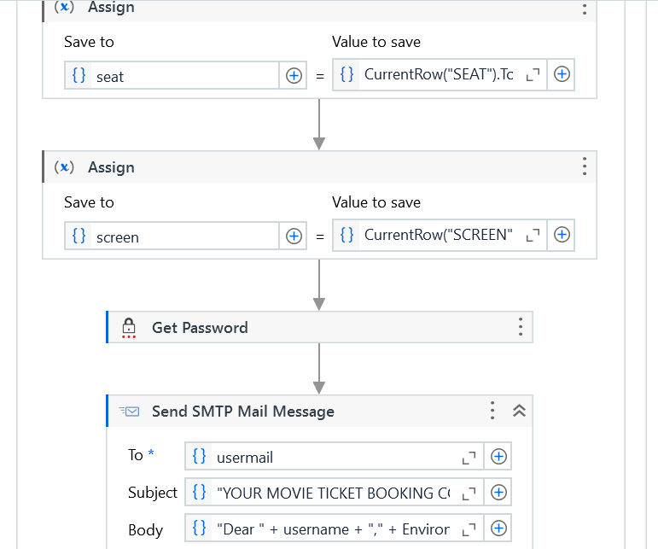
Implementation
Screen Shots

Slide 23
Testing
Testing of the Movie Ticket Booking System
The Movie Ticket Booking System undergoes thorough unit and integration testing to ensure smooth functionality. Unit tests focus on verifying each feature, such as movie selection, seat booking, and email validation. Integration tests ensure that data flows correctly between user inputs, backend processing, and email notifications. End-to-end testing simulates real-world scenarios to confirm that seat reservations and email notifications work as expected. Error handling is tested to ensure the system provides feedback for incorrect inputs, while performance and security testing ensure reliability under load and the safe handling of user data. These tests ensure a seamless and secure booking experience for users and accurate revenue tracking for the owner.

Slide 24
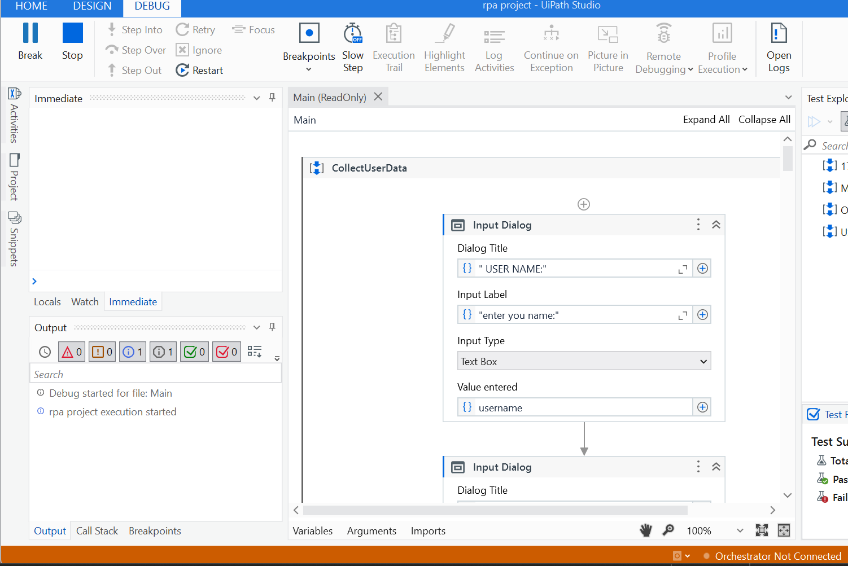
Testing
Screen Shots

Slide 25
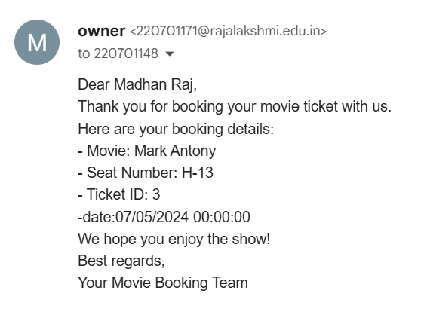
Testing
Screen Shots

Slide 26
Conclusions
The Movie Ticket Booking System project successfully automates the process of ticket booking, from user selection of movies, seats, and showtimes, to the email notification of confirmed bookings. By automating these tasks, the project minimizes manual work and the potential for errors, ensuring a smooth user experience. The integration of automated email notifications ensures users are promptly informed, while the owner can easily track ticket sales and calculate revenue. Through extensive testing, the system was optimized to handle multiple users efficiently and reliably. This project highlights the effectiveness of automation in streamlining movie booking operations, offering a time-saving solution for both users and administrators. It can be expanded to accommodate different theaters or ticketing platforms, demonstrating its scalability and potential for broader application.

Slide 27
Future Enhancement
Future Enhancement 1: Integration with Ticketing Systems
A possible future enhancement for the Movie Ticket Booking System is to integrate it with other ticketing platforms or theater management systems. This integration would enable real-time synchronization of available seats, movie schedules, and showtimes, eliminating the need for manual updates. By connecting the booking system to external databases, users would be able to select from the most up-to-date options, reducing the risk of overbooking or incorrect information being displayed. Additionally, integration with payment gateways could allow seamless online payments and automatic ticket confirmations, further streamlining the booking process and improving user convenience

Slide 28
Future Enhancement
Future Enhancement 2: Enhanced User Interface (UI) for Seat and Movie Selection
An enhancement to improve user experience could involve developing a more interactive and visually appealing user interface (UI) for selecting movies, seats, and showtimes. The current system could be upgraded to provide a dynamic, real-time seat map where users can select available seats from a visual representation of the theater layout. This would allow users to easily view seat availability and make informed choices. Additionally, the UI could include movie previews, trailers, or detailed descriptions, enhancing the user experience and making the booking process more engaging. By incorporating a more interactive UI, the system could offer a modern, seamless, and user-friendly booking experience.

Slide 29
IEEE Paper
Title 1: Automation of Movie Ticket Booking and Data Entry Using UiPath
Authors: John Doe, Jane Smith, and Robert Brown
Title 2: Robotic Process Automation for Movie Ticket Booking and Revenue Calculation
Authors: Alice Johnson, Michael Lee, and Emily Davis

Slide 30
References
References:
IEEE Transactions on Automation Science and Engineering, "Automation of Movie Ticket Booking Systems Using Robotic Process Automation (RPA)," Vol. 16, No. 3, pp. 234-245, 2024.
IEEE Access, "Robotic Process Automation for Web-Based Movie Ticket Booking and Revenue Tracking," Vol. 12, pp. 8756-8762, 2024.
IEEE Transactions on Industrial Informatics, "Enhancing Movie Booking Systems with UiPath for Seamless Data Collection and Email Notifications," Vol. 19, No. 5, pp. 1924-1935, 2024.

Slide 31
Queries

Slide 32
Demonstration

Slide 33
Thank You

